Slide 1
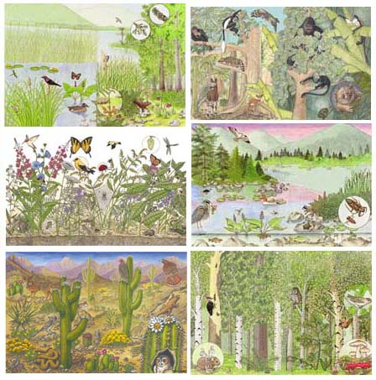
How Do Humans Affect the Environment?
By: Billy Costello
Nick Poplawski
Preeya Achari

Slide 2
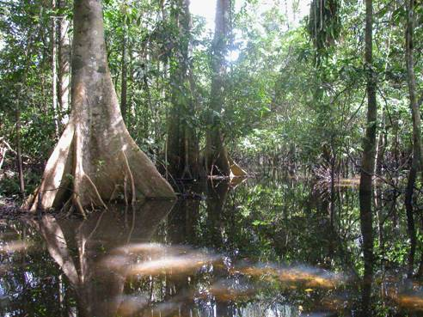
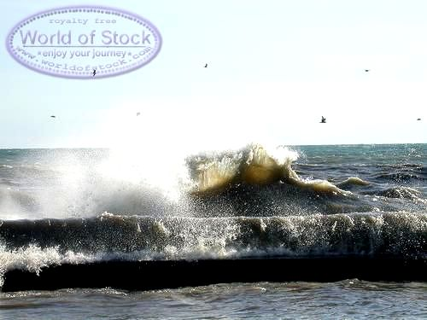
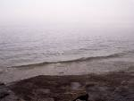
What Do We Do to the Environment?
We litter in many ecosystems. Yet, we do community service to clean them up. We do our share of good and bad things to all environments in the world. We are going to show all the horrible and generous things that we do for our planet. For example, we dump our waste into our oceans. Though on the other hand, we try to plant trees and other plants.

Slide 3
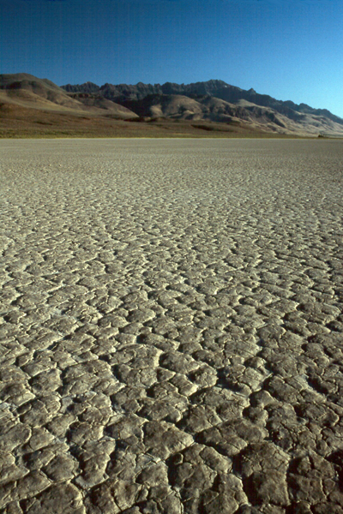
Negative Positive
We pick up litter out of lakes.
We recycle paper and cardboard.
We use other forms of transportation that don’t involve gasoline.
We plant flowers and trees
Sometimes we build bridges and houses around ecosystems
We dump garbage into the ocean.
We use gas a lot and that hurts the atmosphere.
We cut down trees and ruin habitats for trivial reasons
Humans build cities over animal habitats
Humans move dirt which causes dust to rise

Slide 4
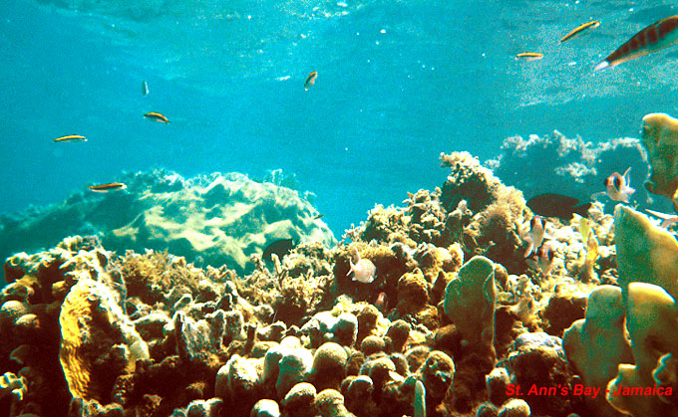
What Can We Do to Stop Failing Ecosystems?
As you can see, the environment is healthy and in great danger in very different ways. Though there are many things we can do. This Go-Animate will tell you some things you can do you need to know about… SAVING THE PLANET!!!
http://goanimate.com/movie/0gdOlGZzg-Fs/1

